Slide 1
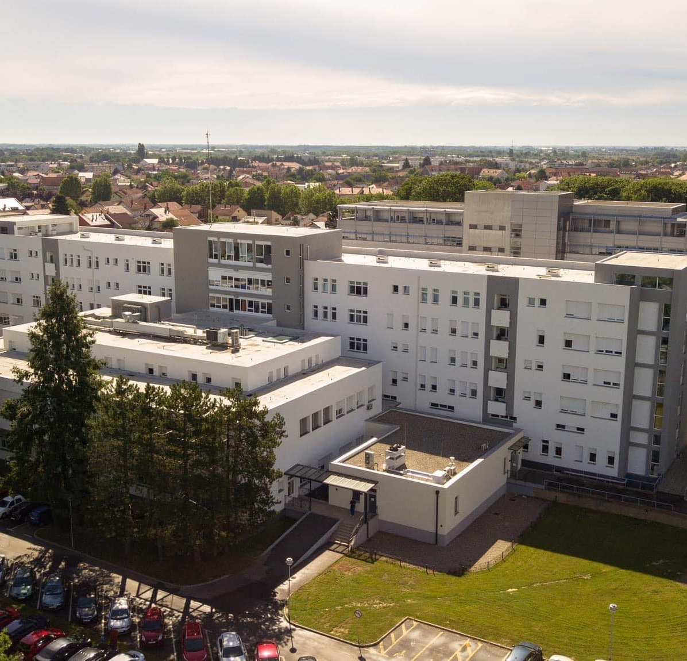



oct angiography quantitative analysis
macular vascular density in healthy human eyes using optical coherence tomography with angiography
a new diagnostic approach
authors:
Vladimira Vučenik dr. med. Ophthalmology departement , County Hospital Čakovec
Vlatko Vučenik IT, software developer

Slide 2
OCT angiography (OCTA) provides a noninvasive method to detect microvascular distortions correlated with eye conditions.
Valuable additional information for:
Classification of diseases according to severity
Monitoring progression of disease
Monitoring the effect of therapy
Monitoring and detecting deviations of the patient group from the healthy population
The importance of quantitative analysis of OCTA

Slide 3
Aim:
To quantify parafoveal vascular density in the superficial capillary plexus (SCP) and deep capillary plexus (DCP) in healthy, human eyes using optical coherence tomography with angiography.
Patients and methods:
61 participants (122 eyes in total) without retinal pathology were included.
All participants underwent a complete ophthalmologic examination, including a 6-mm x 6-mm optical coherence tomography with macular-centered angiography after pupillary dilation.
OCT-A was performed on a commercially available device Swept Source Optopol Revo NX with automatic segmentation of images into superficial capillary plexus (SCP) and deep capillary plexus (DCP).
Images were reviewed manually by researchers. All 6-mm x 6-mm OCT-A images were processed using our purpose-built computer program “OCT Angio analyzer VV”.
Descriptive statistics including mean, standard deviation (SD), range, and percentages were used. We also used correlation analysis .

Slide 4
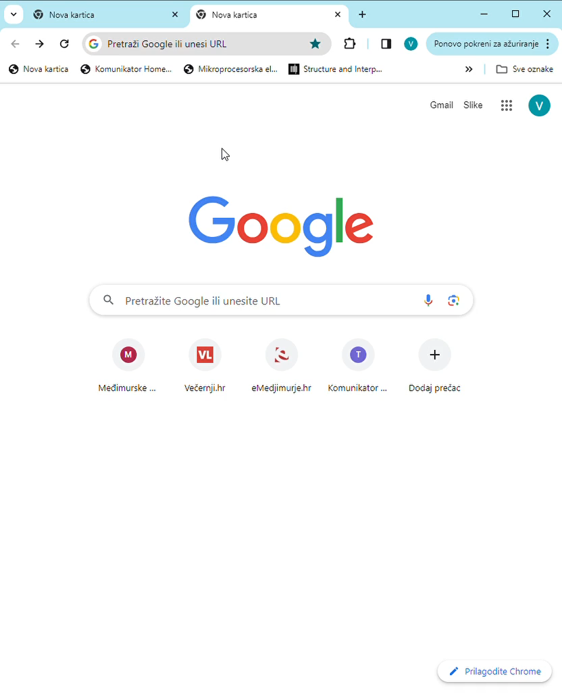
OCT Angio analizator VV
User friendly, open-source softweare toolbox for OCTA images analysis
www:
https://octangio.info
GitHub public-repository:
https://github.com/Vucenik/oct

Slide 5
Results:
All 122 healthy, human eyes (female=36; M=25) with good quality images were included in the analysis.
AGE GROUPS | 18-29 | 30-39 | 40-49 | 50-59 | 60-69 | > 70 | MEAN
SUPERFICIAL VASCULAR DENSITY | 36,35% | 38,59% | 36,33% | 34,98% | 32,38% | 32,33% | 34,7%
DEEP VASCULAR DENSITY | 49,24% | 49,87% | 48,90% | 48,87% | 47,82% | 46,76% | 48,27%

Slide 6
VESSEL DENSITY
AGE GROUPS
VESSEL DENSITY
AGE GROUPS

Slide 7
Discussion:
Several recent studies have evaluated the vascular density of parafoved area in healthy human eyes with similar results.
Lavia, Carlo MD*,†; Bonnin, Sophie MD*; et al. Vessel density of superficial, intermediate, and deep capillary plexuses using optical coherence tomography angiography. Retina 39:p247-258, Feb 2019.
Pasha Anvari MD MPH, Amin Najafi, MD et al. Superficial and Deep Foveal Avascular Zone Area Measurement in Healthy Subjects Using Two Different Spectral Domain Optical Coherence Tomography Angiography Device. J Ophthalmic Vis Res: 2020 Oct-Dec 15(4) 517-523.
Lavia, Carlo MD, et al. Retinal Capillary Plexus Pattern and Density from Fovea to Periphery Measured in Healthy Eyes with Swept-Source Optical Coherence Tomography Angiography. Scientific Reports 10: 1474 (2020).
Vascular density is stable until the age of 50 with a slight increase for the 30-39 age groups, after the age of 50 in all groups the vascular density begins to progressively decrease.
We can detect deviations of the patients vascular density from the reference healthy population.

Slide 8
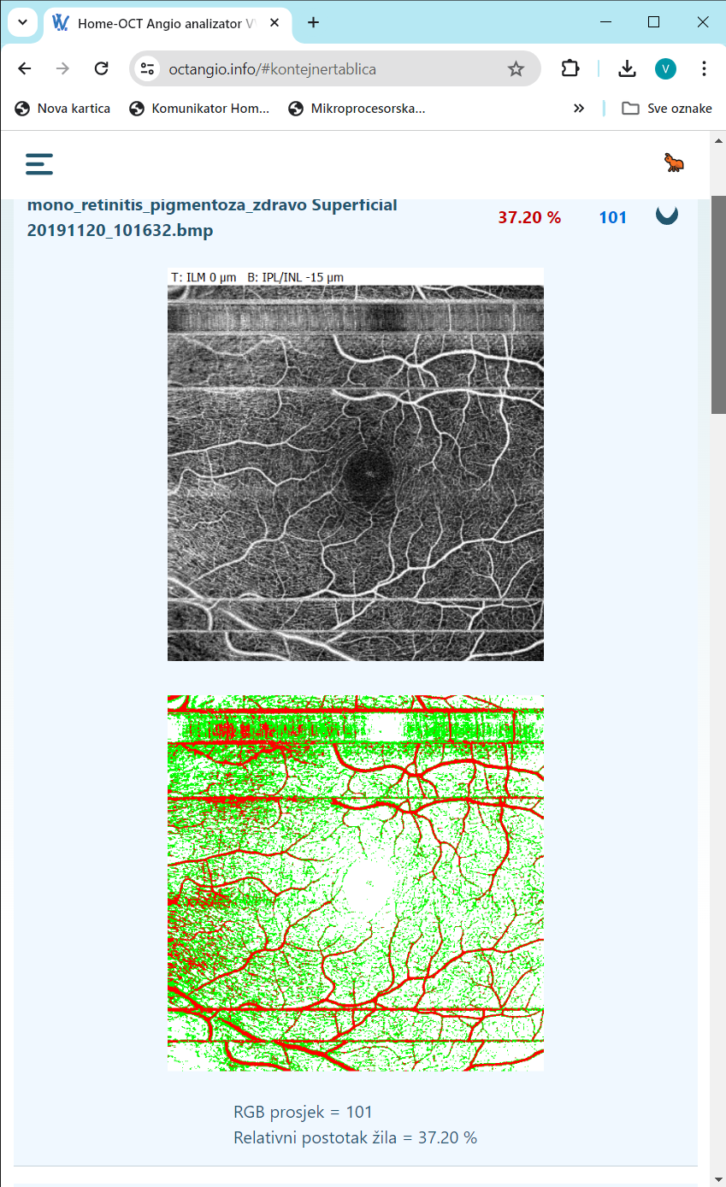
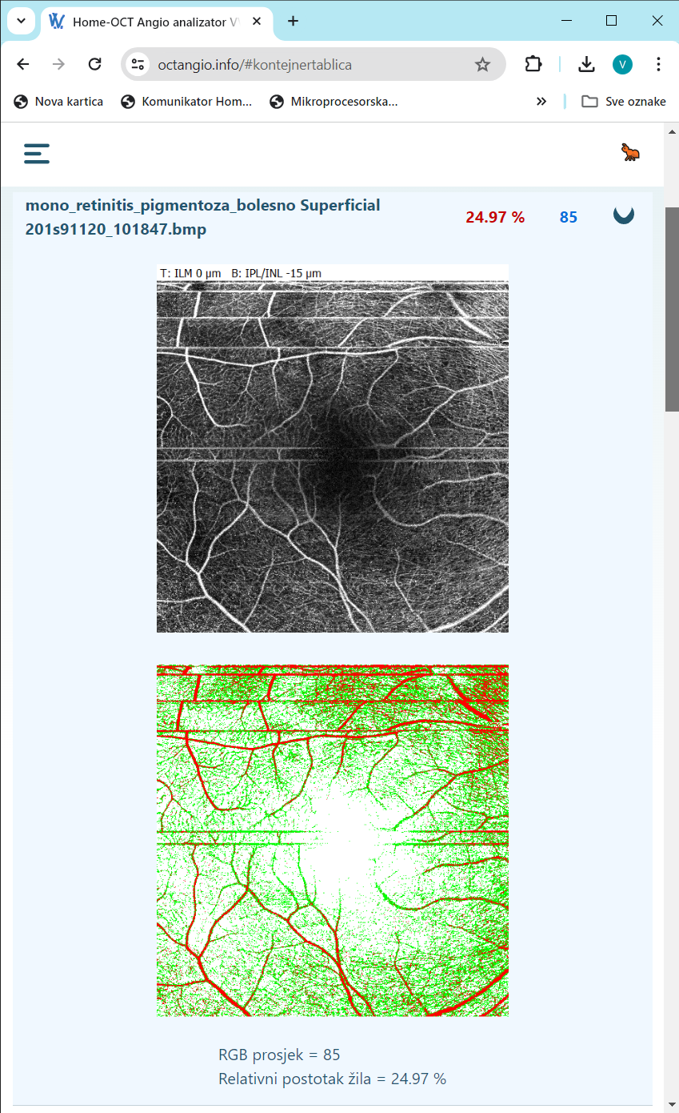
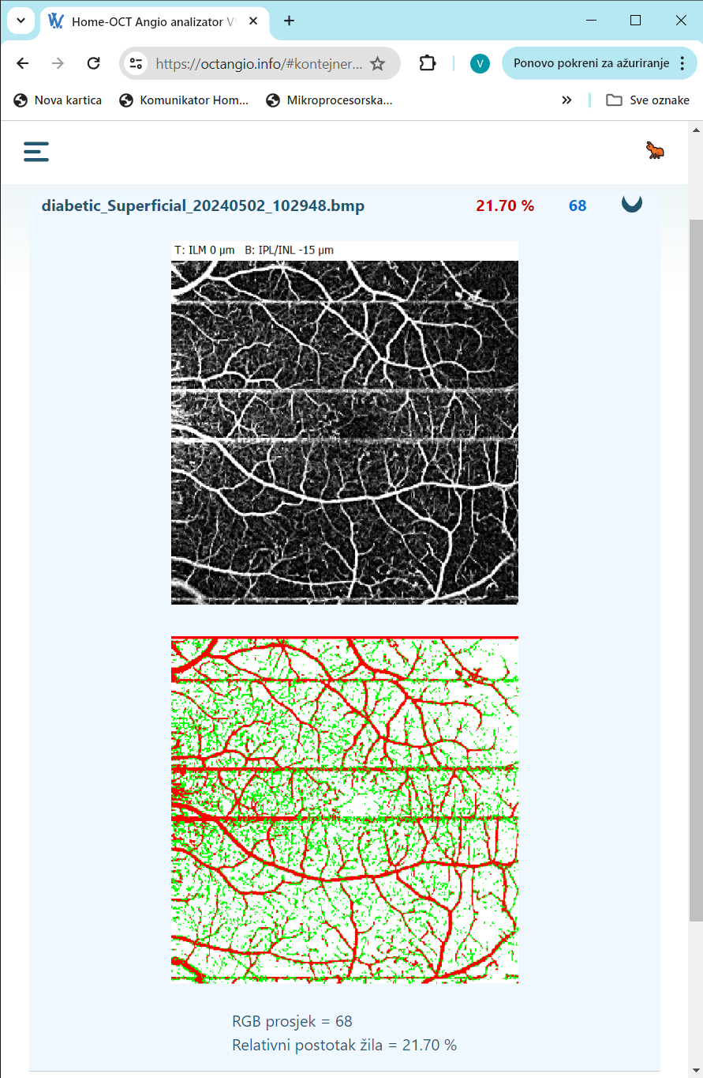
superficial
HEALTHY 37.20%
RETINITIS 24.97%
DIABETIC 21,70%

Slide 9
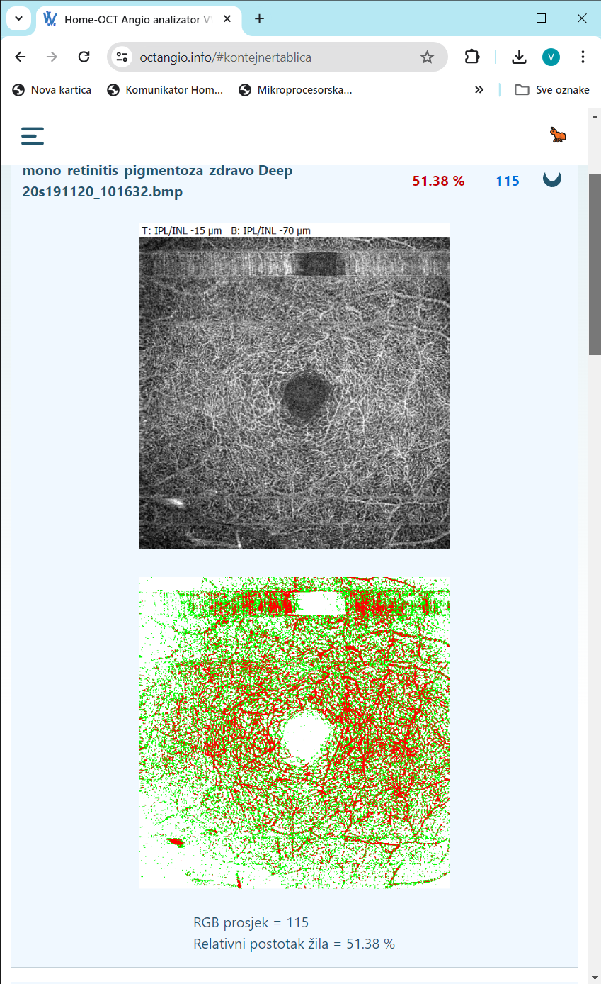
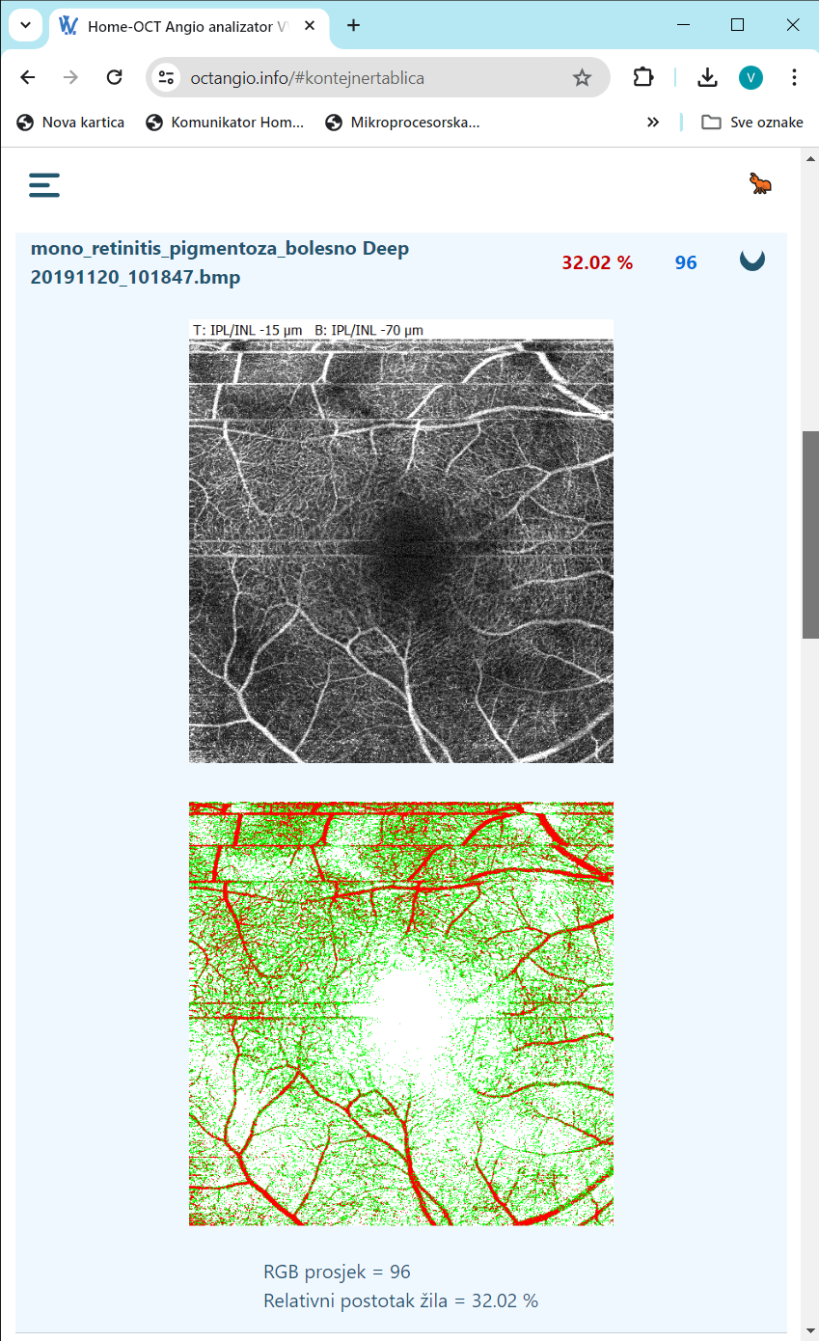
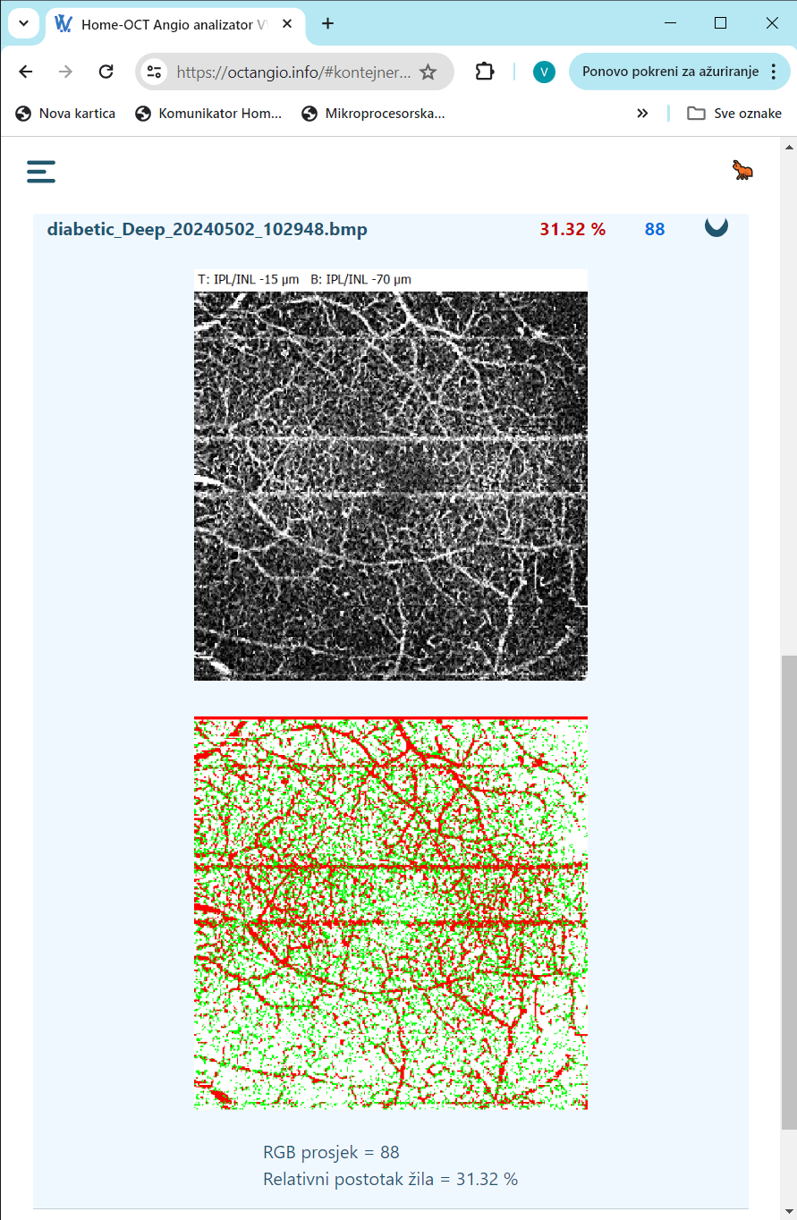
DEEP
HEALTHY 51,38%
RETINITIS 31,02%
DIABETIC 31,32%

Slide 10
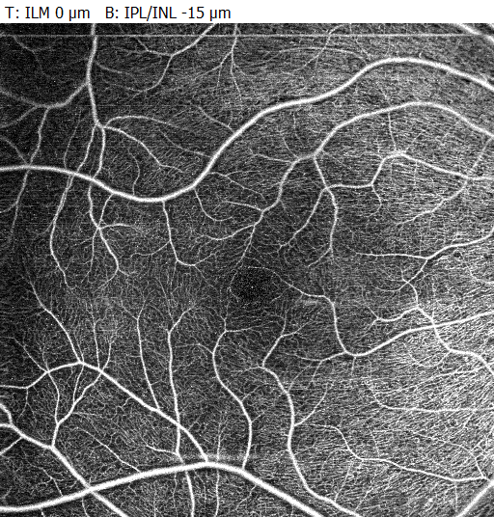
Challenges of verification and validation of vASCULAR density measurement
The quality of the image and the imperfections present can have a significant impact on the calculation of vessel density - challenges of repeatability and reproducibility
Different calculation algorithms, selected acceptable limit values (threshold) ​​and selected image segments affect the final calculation of vessel density - challenges of verification and standardization

Slide 11
Conclusion:
Advanteges:
The use of non-invasive optical coherence tomography with angiography and the processing of standardized digitized images thus obtained with the easy to use computer program "OCT Angio analyzer VV" proved to be acurate and repeatable method for quantifying individual vascular densities within the macula.
Disadvantages:
The obtained data in terms of trends and relative amounts are comparable to data from similar studies that studied macular vascular density in healthy individuals. Differences in the devices used, different versions of computer programs for analyzes with different thresholds of sensitivity make it impossible to compare the obtained data in absolute amounts between different studies.
We hope this program will contribute to standardisation of OCT angiography data analysis.

Slide 12

Thank you for your attention

